Slide 1
Real Estate Management System
Presenters :
Salina Pradhan
Rojan Adhikari

Slide 2
Project Overview
01
Project Title
Real Estate Management System
02
Team Size
2 Members
03
Decided Frontend
Web Design with HTML/CSS
04
Project Duration
6 month

Slide 3
Project Importance
Save time
Property Listing
No commission for broker
Booking and Scheduling
Search and Filter

Slide 4
Market Value of this Project
1
It helps to provide real time information
2
To provide security for confidential data
3
The ability to save money

Slide 5
Limitations
Complexity
Cost of Purchasing & Implementing
Data security risks
Dependency on Internet

Slide 6
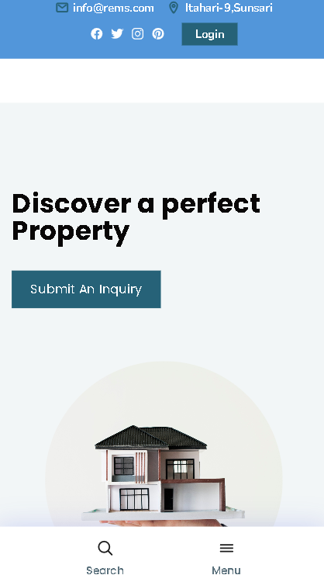
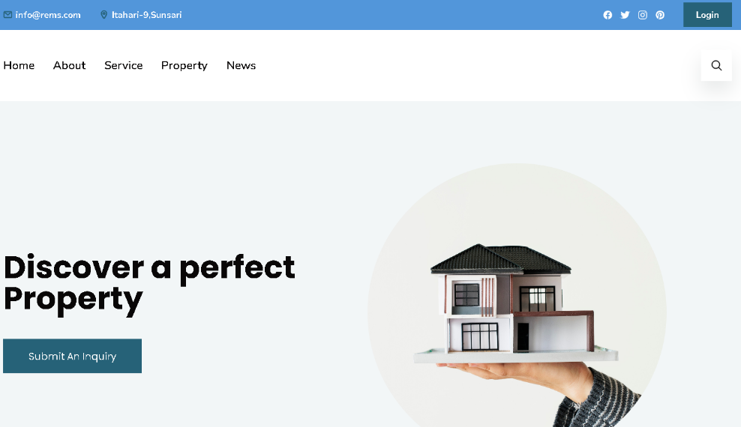
Project client’s view

